Slide 1
Water Bath Heaters 101

Slide 2
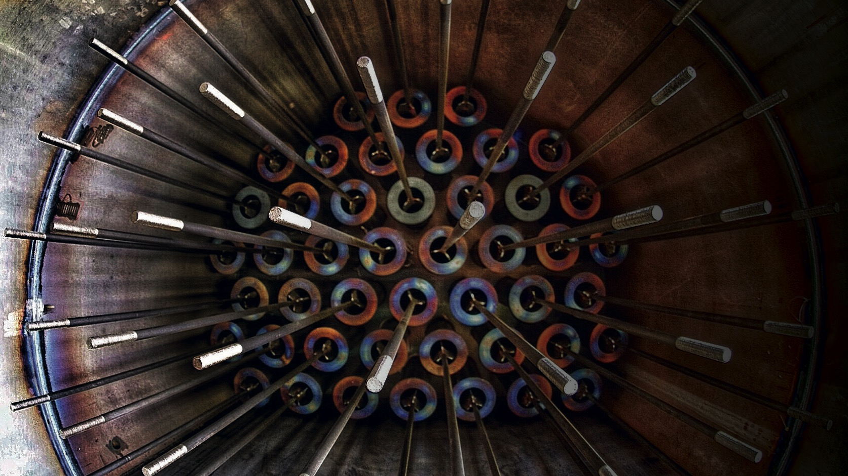
WHERE
NATURE
AND
TECHNOLOGY
MEET

Slide 3
Water Bath Heater Principle
Water temp. is kept steady
Fast acting system
Efficient in fuel gas use
Gas temp. is obtained mixing hot & cold gas
Fast & accurate regulating
Mixing ratio is regulated from gas temp. controller at gas outlet
PRS outlet temp. loss is calculated from ΔP

Slide 4
Water Bath Heater Principle
TT
Bypass valve opened, gas passes through unheated
Bypass valve closed, gas is diverted to the water bath heater. Internal bypass is open, so gas can pass unheated.
Water is heated and kept at a steady temperature.
The hot water heats the gas that flows through the bundle. Hot gas is then mixed with cold gas from the internal bypass.
If the internal bypass is closed, all gas is heated. The bypass valve position is controlled by the outlet gas temperature.

